Slide 1

The Heterogeneous Multiscale Methods:
A 1D Elliptic PDE Demonstration

Slide 2
Workshop Structure
This session on the Heterogeneous Multiscale Methods (HMM) is divided into four parts:
The Governing Equation and Multiscale Property Field
Deterministic Approach – Solving the multiscale problem without the HMM
The HMM – Coupling macroscale and microscale domains
Results – Solution comparison and error analysis
A companion Jupyter notebook is available with all model code.

Slide 3

Workshop Materials
Want to download the workshop?
This workshop aims to proliferate the technique.
Scan the QR code, submit your email address, and we will send you the workshop
This includes all the slides, models, and code.
If you’re interested, we will also send you all the updates to the workshop

Slide 4
The Problem
Multiscale fields and why they are computationally challenging

Slide 5
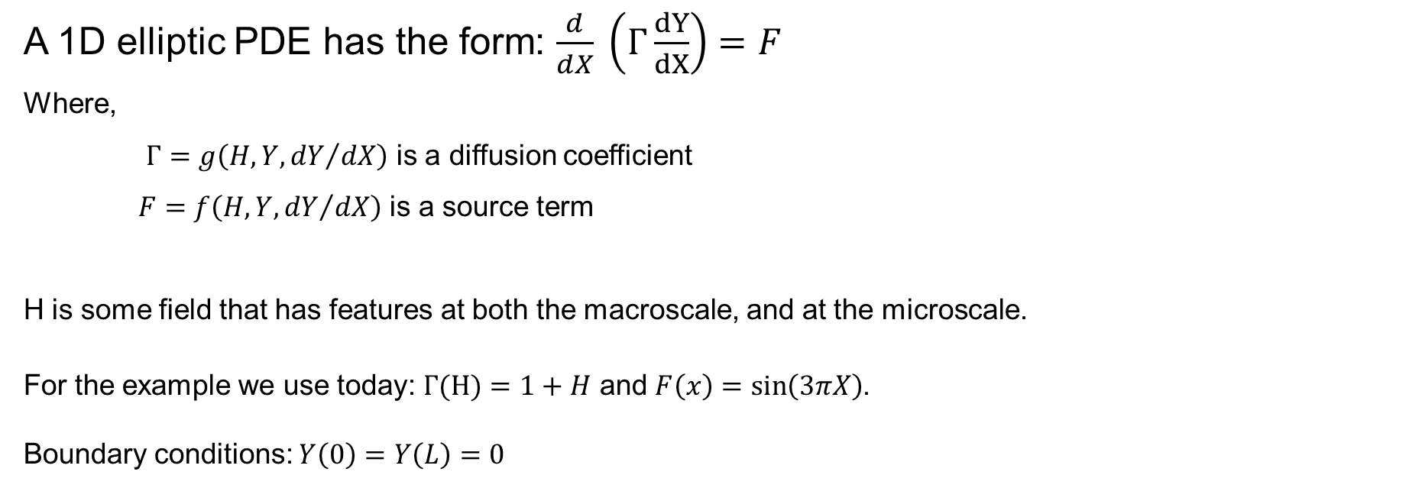
The Governing Equation
A 1D elliptic PDE has the form: $\frac{d}{dX} \left(Γ\frac{dY}{dX}\right)=F$
Where,
$Γ=g\left(H, Y,{dY}/{dX}\right)$ is a diffusion coefficient
$F=f\left(H, Y,{dY}/{dX}\right)$ is a source term
H is some field that has features at both the macroscale, and at the microscale.
For the example we use today: $Γ(H)=1+H$ and $F\left(x\right)=\sin\left(3πX\right)$.
Boundary conditions: $Y\left(0\right)=Y\left(L\right)=0$

Slide 6
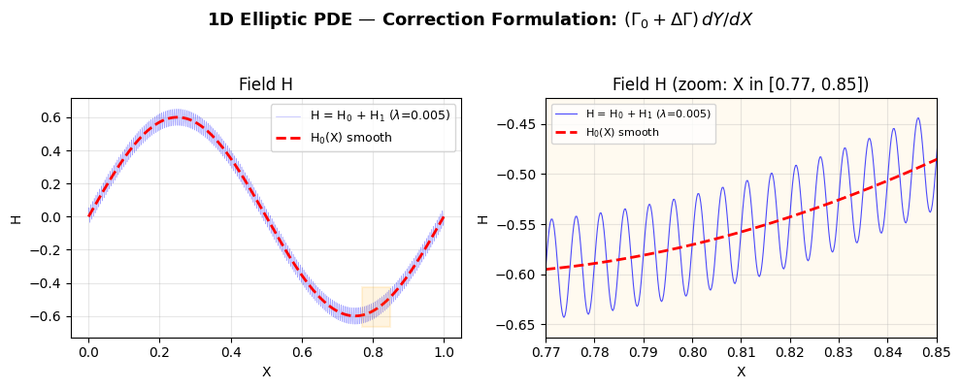

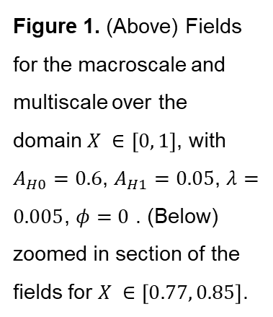
The Multiscale Field H
Separation of scales
The property field H contains both macroscale and microscale features.
$H_{0}\left(X\right)=A_{H0} sin⁡(2πX)$ is the smooth macroscale variation
$H_{1}\left(X, λ,φ\right)=A_{H1} sin⁡(\frac{2πX}{λ}+φ)$is the microscale perturbation
The full field is $H\left(X, λ,φ\right)=H_{0}\left(X\right)+H_{1}\left(X, λ,φ\right)$, where $λ≪L$.
Figure 1. (Above) Fields for the macroscale and multiscale over the domain $X ∈\left[0, 1\right]$, with $A_{H0}=0.6$, $A_{H1}=0.05$, $λ=0.005$, $φ=0$ . (Below) zoomed in section of the fields for $X ∈\left[0.77, 0.85\right]$.

Slide 7
Three Modelling Scenarios
Smooth Macroscale, Deterministic, and HMM

Slide 8
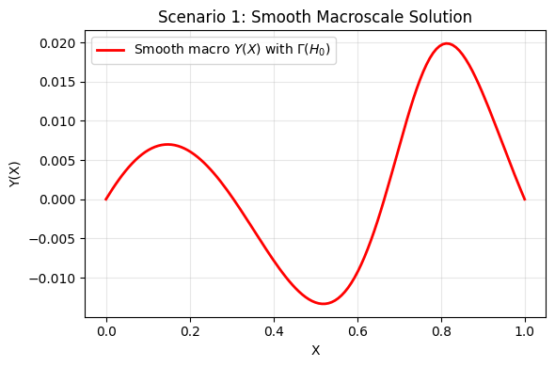

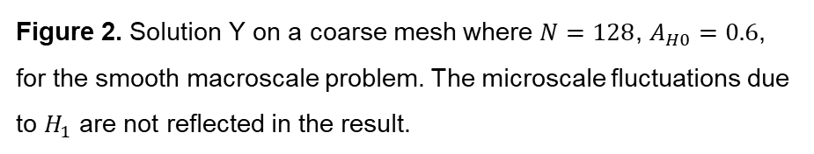

Scenario 1: Smooth Macroscale
$$\frac{d}{dX} \left(Γ\frac{dY}{dX}\right)=F$$
H = $H_{0}=A_{H0} sin⁡(2πX)$
$Γ(H)=1+H$
$F\left(x\right)=\sin\left(3πX\right)$
Only the smooth macroscale field $H_{0}\left(X\right)$ is used (no microscale features).
Solved on a coarse mesh, using FEM, with N = 64 elements.
Computationally inexpensive but ignores microscale effects entirely.
Figure 2. Solution Y on a coarse mesh where $N=128$, $A_{H0}=0.6$, for the smooth macroscale problem. The microscale fluctuations due to $H_{1}$ are not reflected in the result.

Slide 9
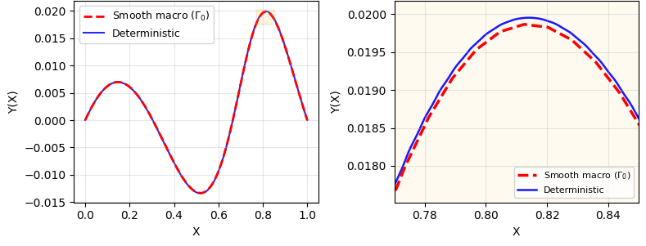

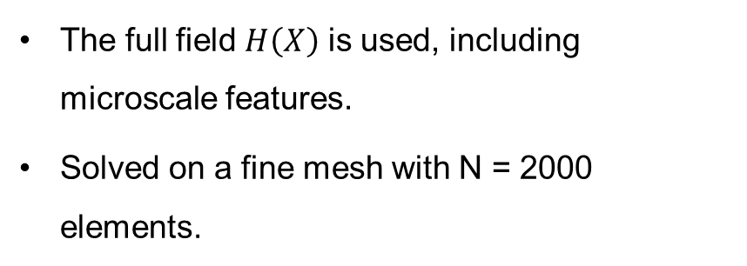
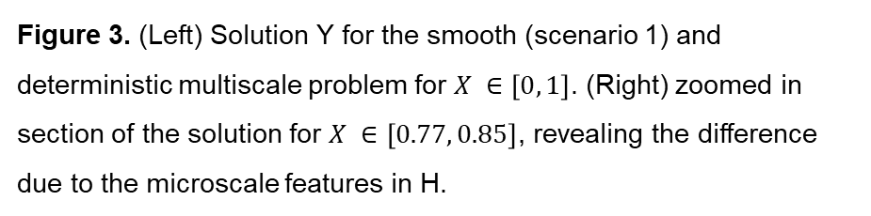
Scenario 2: Deterministic
$$\frac{d}{dX} \left(Γ\frac{dY}{dX}\right)=F$$
$$H\left(X, λ,φ\right)=H_{0}\left(X\right)+H_{1}\left(X, λ,φ\right)$$
$Γ(H)=1+H$
$F\left(x\right)=\sin\left(3πX\right)$
The full field $H\left(X\right)$ is used, including microscale features.
Solved on a fine mesh with N = 2000 elements.
Figure 3. (Left) Solution Y for the smooth (scenario 1) and deterministic multiscale problem for $X ∈\left[0, 1\right]$. (Right) zoomed in section of the solution for $X ∈\left[0.77, 0.85\right]$, revealing the difference due to the microscale features in H.

Slide 10

Scenario 2: Deterministic
$$\frac{d}{dX} \left(Γ\frac{dY}{dX}\right)=F$$
$$H\left(X, λ,φ\right)=H_{0}\left(X\right)+H_{1}\left(X, λ,φ\right)$$
$Γ(H)=1+H$
$F\left(x\right)=\sin\left(3πX\right)$
Table 1. Advantages and disadvantages to the deterministic methods
Advantages | Disadvantages
Accurate across all scales - captures both macroscale and microscale effects. No approximation or homogenisation needed. | Requires a very fine mesh (N = 2000 elements) to resolve microscale features. Computationally expensive - the mesh must capture all features of H = H0 + H1

Slide 11
Introducing the HMM
Coupling macroscale and microscale through homogenisation

Slide 12
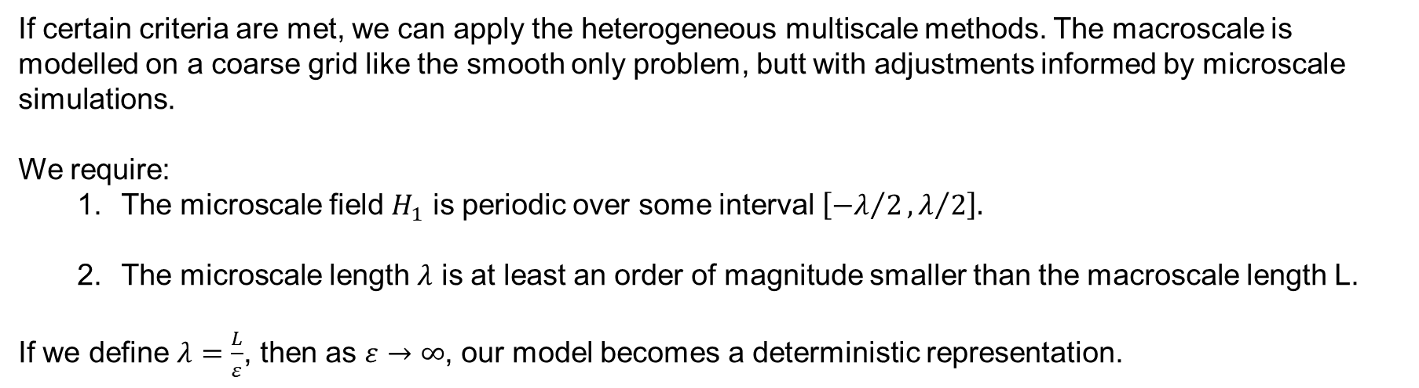
HMM Overview
HMM for the 1D Elliptic PDE
If certain criteria are met, we can apply the heterogeneous multiscale methods. The macroscale is modelled on a coarse grid like the smooth only problem, butt with adjustments informed by microscale simulations.
We require:
The microscale field $H_{1}$ is periodic over some interval $\left[{−λ}/2,λ/2\right].$
The microscale length $λ$ is at least an order of magnitude smaller than the macroscale length L.
If we define $λ=\frac{L}{ε}$, then as $ε→∞$, our model becomes a deterministic representation.

Slide 13
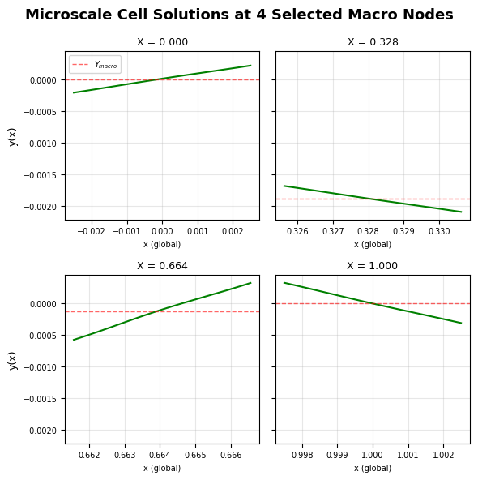
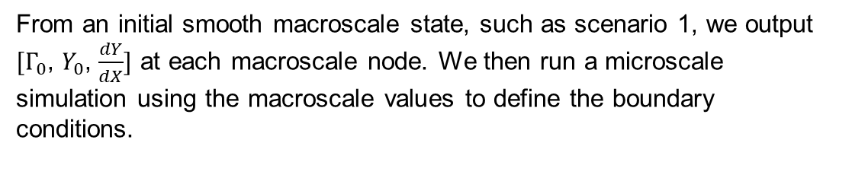

HMM Overview
Microscale
From an initial smooth macroscale state, such as scenario 1, we output ${[Γ}_{0}$, $Y_{0}$, $\frac{dY}{dX}]$ at each macroscale node. We then run a microscale simulation using the macroscale values to define the boundary conditions.
Microscale is then defined as:
$$\frac{d}{dx}\left[γ\frac{dy}{dx}\right]=f_{i}$$
For $x ∈[{−λ}/2, λ/2]$
Boundary conditions:
Enforce consistency of the microscale solution gradient with the macroscale gradient: $y\left(λ/2\right)=y\left({−λ}/2\right)+λ\frac{dY}{dX}$
Periodic flux:$Γ{\left.\frac{dy}{dx}\right|}_{{−λ}/2}=Γ{\left.\frac{dy}{dx}\right|}_{λ/2}$
Constrain the solution at the centre of the domain: $y\left(0\right)=Y$
The result is that if there are no microscale features in $H_{1}=0$, then the microscale recovers the smooth macroscale solution.
Figure 4. Example microscale solutions (green) for four locations in the macroscale.

Slide 14
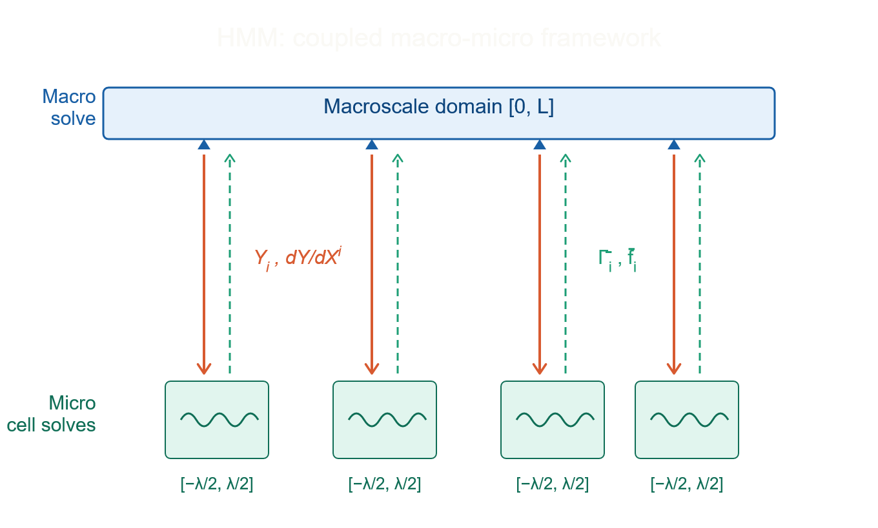
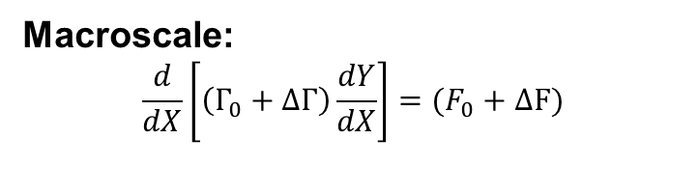

HMM Overview
HMM for the 1D Elliptic PDE
Macroscale:
$$\frac{d}{dX}\left[\left(Γ_{0}+ΔΓ\right)\frac{dY}{dX}\right]=(F_{0}+ΔF)$$
Microscale at macroscale node i, for $x ∈[{−λ}/2, λ/2]$:
$$\frac{d}{dx}\left[Γ_{i}\frac{dy}{dx}\right]=F_{i}$$
$\overline{F_{i}}=\frac{1}{λ}\int_{{−λ}/2}^{λ/2}{f(x)}dx$
$\overline{Γ_{i}}={\left(\frac{1}{λ}\int_{{−λ}/2}^{λ/2}{\frac{1}{γ(x)}}dx\right)}^{−1}$
$ΔF_{i}=\overline{F_{i}}−{F_{0}}_{i}$
$ΔΓ_{i}=\overline{Γ_{i}}−Γ_{0}_i$

Slide 15

HMM Overview
HMM for the 1D Elliptic PDE
Iterative Algorithm:
Initial macro solve with smooth $Γ(H_{0})$ and $F(X)$.
At each macro node: solve microscale cell problem to get $\overline{Γ}$, $\overline{F}$.
Compute corrections: $ΔΓ=\overline{Γ} −Γ_{0}$, $ΔF=\overline{F} −F_{0}$.
Re-solve macro.
Check convergence: $\frac{\left\|dY\right\|}{\left\|Y\right\|}<$ tolerance. If not converged, repeat from step 2

Slide 16
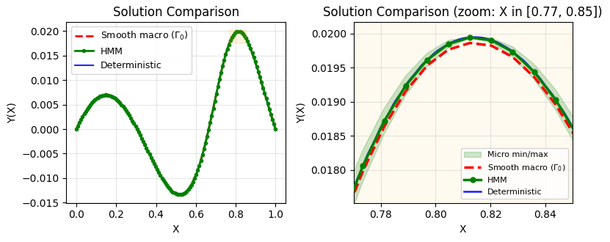
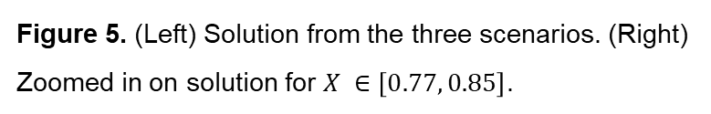
Results: Solution Comparison
Figure 5. (Left) Solution from the three scenarios. (Right) Zoomed in on solution for $X ∈\left[0.77, 0.85\right]$.

Slide 17
Results: Corrections and Error Analysis
Quantifying the HMM accuracy and efficiency
Error Summary:
L2 error (HMM vs Deterministic): 5.3e-06
L-infinity error: 1.8e-05
Table 2. Key parameters and results
Quantity | Value | Notes
Macro mesh elements | 128 | Coarse
Micro mesh elements | 64 | Per cell
Deterministic mesh elements | 2000 | Fine
HMM iterations to converge | 2 | Fast convergence
Total micro solves | 256 | 128 nodes x 2 iterations

Slide 18
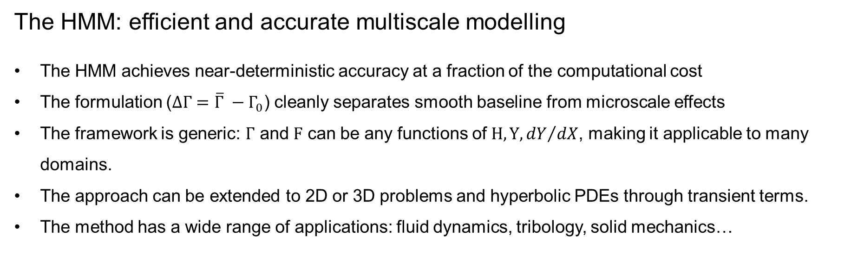
Conclusions
The HMM: efficient and accurate multiscale modelling
The HMM achieves near-deterministic accuracy at a fraction of the computational cost
The formulation ($ΔΓ=\overline{Γ} −Γ_{0}$) cleanly separates smooth baseline from microscale effects
The framework is generic: $Γ$ and $F$ can be any functions of $H, Y, {dY}/{dX}$, making it applicable to many domains.
The approach can be extended to 2D or 3D problems and hyperbolic PDEs through transient terms.
The method has a wide range of applications: fluid dynamics, tribology, solid mechanics…

